Slide 1


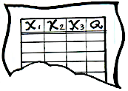

We can use Machine Learning + A/B Test to predict how effects vary.
$$\hat{Effect}={\hat{Y}}_{T}\left(X\right)−{\hat{Y}}_{U}(X)$$
Machine Learning Algorithm
Machine Learning Algorithm
Model for the treated outcome
Model for the untreated outcome
Y_{T}
Y_{U}
X₁
X₂
Y_{T}
Y_{U}
X₁
X₂
No
7
Red
Yes
?
X₁
X₂
Y_{T}
Y_{U}
15
Green
?
Blue
No
?
9
Blue
?
No
12
3
Blue
?
?
5
Red
?
Yes
6
Blue
Yes
?
?
Yes
No
?
Data Instance
Labeled Data
(Control)
Labeled Data
(Treatment)

Slide 2
Key Takeaway We can also use A/B test data to evaluate causal decisions.
$$N×ℙ\left[D=1\right]×\left(𝔼\left[Value | D=1,T=1\right]−𝔼[Value|D=1,T=0]\right)$$
Fraction treated by
the decision rule.
Average effect for those treated
by the decision rule.

Slide 3
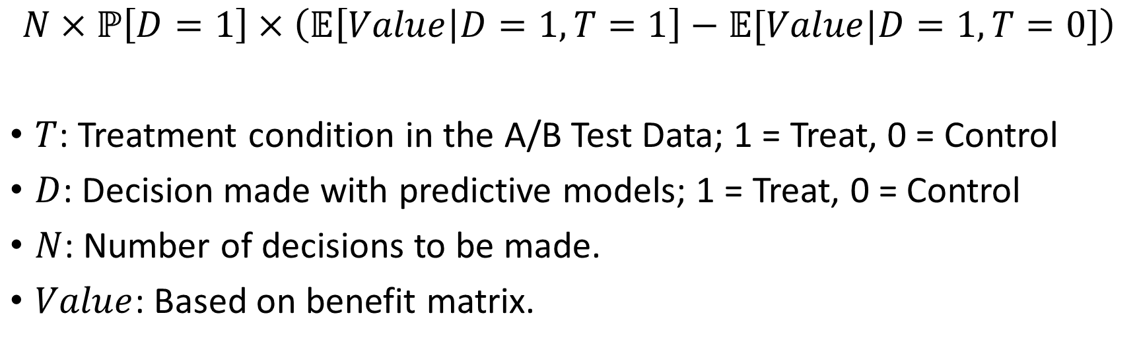
Effect of Decision Rule
$$N×ℙ\left[D=1\right]×\left(𝔼\left[Value | D=1,T=1\right]−𝔼[Value|D=1,T=0]\right)$$
$T$: Treatment condition in the A/B Test Data; 1 = Treat, 0 = Control
$D$: Decision made with predictive models; 1 = Treat, 0 = Control
$N$: Number of decisions to be made.
$Value$: Based on benefit matrix.

Slide 4
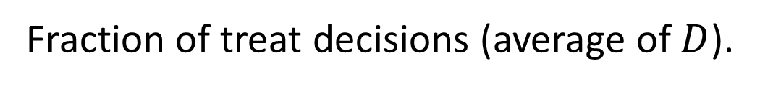
Effect of Decision Rule
$$N×ℙ\left[D=1\right]×\left(𝔼\left[Value | D=1,T=1\right]−𝔼[Value|D=1,T=0]\right)$$
Average value when not treated (estimate from cases
where treatment is decided but not applied).
Average value when treated (estimate from cases
where treatment is decided and applied).
Fraction of treat decisions (average of $D$).

